Slide 1
UNIT V APPLICATION LAYER

Slide 2
OUTLINE
Principles of Network Applications
The Web and HTTP
Electronic Mail in the Internet
DNS—The Internet’s Directory Service,
Peer-to-Peer Applications
Video Streaming and Content Distribution Networks

Slide 3
Application Layer
The application layer in the OSI model is the closest layer to the end user which means that the application layer and end user can interact directly with the software application.
The application layer programs are based on client and servers.

Slide 4
Application Layer
The Application layer includes the following functions:
Identifying communication partners: The application layer identifies the availability of communication partners for an application with data to transmit.
Determining resource availability: The application layer determines whether sufficient network resources are available for the requested communication.
Synchronizing communication: All the communications occur between the applications requires cooperation which is managed by an application layer.

Slide 5
Services of Application Layers
1. Network Virtual terminal:
An application layer allows a user to log on to a remote host.
To do so, the application creates a software emulation of a terminal at the remote host.
The user's computer talks to the software terminal, which in turn, talks to the host.
The remote host thinks that it is communicating with one of its own terminals, so it allows the user to log on.
2. File Transfer, Access, and Management (FTAM):
An application allows a user to access files in a remote computer, to retrieve files from a computer and to manage files in a remote computer.
FTAM defines a hierarchical virtual file in terms of file structure, file attributes and the kind of operations performed on the files and their attributes.

Slide 6
Services of Application Layers
3. Addressing:
To obtain communication between client and server, there is a need for addressing.
When a client made a request to the server, the request contains the server address and its own address.
The server response to the client request, the request contains the destination address, i.e., client address.
To achieve this kind of addressing, DNS is used.
4. Mail Services: An application layer provides Email forwarding and storage.
5. Directory Services: An application contains a distributed database that provides access for global information about various objects and services.
6. Authentication: It authenticates the sender or receiver's message or both.

Slide 7
Network Application Architecture
Application architecture is of two types:
1. Client-server architecture
2. P2P (peer-to-peer) architecture

Slide 8
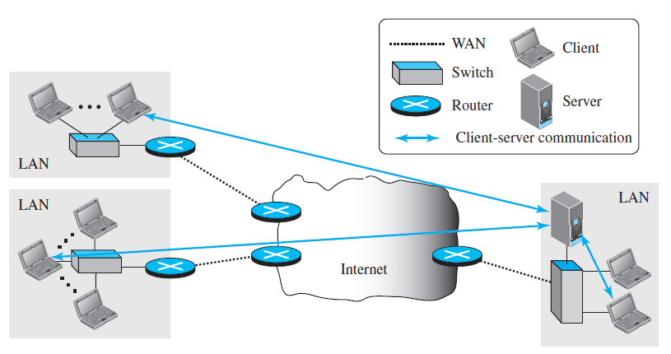
Client-server architecture
An application program running on the local machine sends a request to another application program is known as a client, and a program that serves a request is known as a server.
For example, when a web server receives a request from the client host, it responds to the request to the client host.

Slide 9
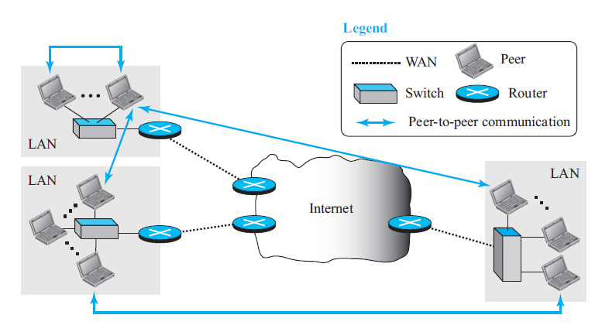
P2P (peer-to-peer) architecture
It has no dedicated server in a data center.
The peers are the computers which are not owned by the service provider.
Most of the peers reside in the homes, offices, schools, and universities.
The peers communicate with each other without passing the information through a dedicated server, this architecture is known as peer-to-peer architecture.
The applications based on P2P architecture includes file sharing and internet telephony.

Slide 10
Standard Client-Server Protocols
WORLD WIDE WEB AND HTTP
ELECTRONIC MAIL
SMPT
DOMAIN NAME SYSTEM (DNS)
Simple Network Management Protocol (SNMP)

Slide 11
WORLD WIDE WEB
The World Wide Web (abbreviated WWW or Web)
The Web today is a repository of information in which the documents, called web pages, are distributed all over the world and related documents are linked together.
The linking of web pages was achieved using a concept called hypertext.
Today, the term hypertext, coined to mean linked text documents, has been changed to hypermedia, to show that a web page can be a text document, an image, an audio file, or a video file.

Slide 12
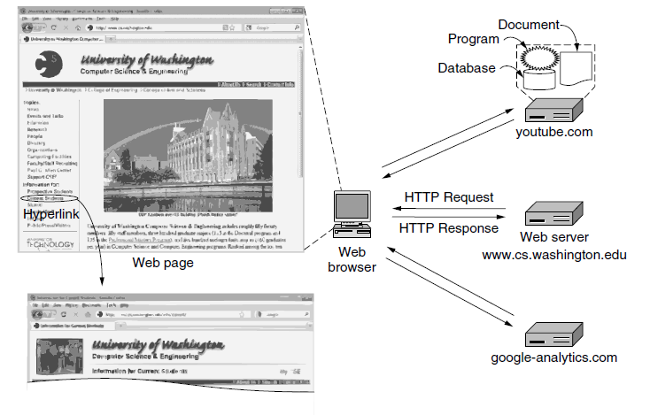

Slide 13
1. What is the page called?
2. Where is the page located?
3. How can the page be accessed?

Slide 14
The browser determines the URL (by seeing what was selected).
The browser asks DNS for the IP address of the serverwww.cs.washington.edu.
DNS replies with 128.208.3.88.
The browser makes a TCP connection to 128.208.3.88 on port 80, the well-known port for the HTTP protocol.
It sends over an HTTP request asking for the page /index.html.
6. The www.cs.washington.edu server sends the page as an HTTP
response, for example, by sending the file /index.html.
7. If the page includes URLs that are needed for display, the browser fetches the other URLs using the same process. In this case, the URLs include multiple embedded images also fetched from www.cs.washington.edu, an embedded video from youtube.com, and a script from google-analytics.com.
8. The browser displays the page /index.html as it appears in Fig. 7-18.
9. The TCP connections are released if there are no other requests to
10.the same servers for a short period.

Slide 15
WWW Architecture
The WWW today is a distributed client-server service, in which a client using a browser can access a service using a server.
However, the service provided is distributed over many locations called sites.
Each site holds one or more web pages. Each web page, however, can contain some links to other web pages in the same or other sites.
In other words, a web page can be simple or composite.
A simple web page has no links to other web pages; a composite web page has one or more links to other web pages. Each web page is a file with a name and address.

Slide 16
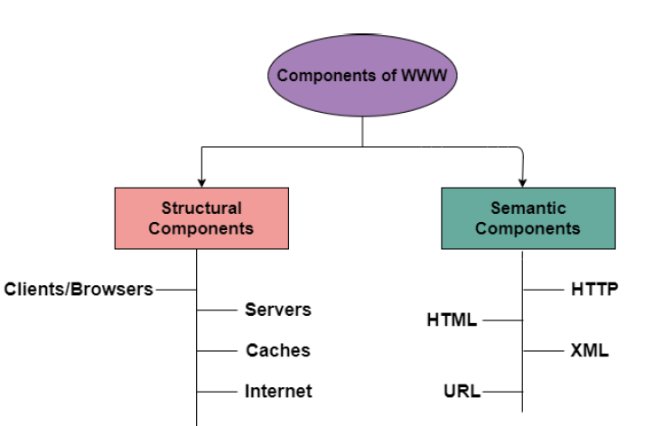
Components of WWW
The Components of WWW mainly falls into two categories:
1. Structural Components
2. Semantic Components

Slide 17
Client/Browser

Slide 18
Client/Browser
The Client/Web browser is basically a program that is used to communicate with the webserver on the Internet.
Each browser mainly comprises of three components and these are:
Controller
Interpreter
Client Protocols
The Controller mainly receives the input from the input device, after that it uses the client programs in order to access the documents.
After accessing the document, the controller makes use of an interpreter in order to display the document on the screen.
An interpreter can be Java, HTML, javascript mainly depending upon the type of the document.
The Client protocol can be FTP, HTTP, TELNET.

Slide 19
Server
The Computer that is mainly available for the network resources and in order to provide services to the other computer upon request is generally known as the server.
The Web pages are mainly stored on the server.
Whenever the request of the client arrives then the corresponding document is sent to the client.
The connection between the client and the server is TCP.
It can become more efficient through multithreading or multiprocessing. Because in this case, the server can answer more than one request at a time.

Slide 20
URL
URL is an abbreviation of the Uniform Resource Locator.
It is basically a standard used for specifying any kind of information on the Internet.
In order to access any page the client generally needs an address.
To facilitate the access of the documents throughout the world HTTP generally makes use of Locators.
url = "https://www.example.com:8080/path/to/resource"

Slide 21
URL
URL mainly defines the four things:
Protocol : It is a client/server program that is mainly used to retrieve the document. A commonly used protocol is HTTP.
Host Computer: It is the computer on which the information is located. It is not mandatory because it is the name given to any computer that hosts the web page.
Port: The URL can optionally contain the port number of the server. If the port number is included then it is generally inserted in between the host and path and is generally separated from the host by the colon.
PATH It indicates the pathname of the file where the information is located.

Slide 22
WWW Components
HTML
HTML is an abbreviation of Hypertext Markup Language.
It is generally used for creating web pages.
It is mainly used to define the contents, structure, and organization of the web page.
XML
XML is an abbreviation of Extensible Markup Language. It mainly helps in order to define the common syntax in the semantic web.

Slide 23
HTTP
HTTP stands for Hypertext Transfer Protocol and is mainly used to access the data on the World Wide Web i.e (WWW).
The HTTP mainly functions as the combination of FTP(File Transfer Protocol) and SMTP(Simple Mail Transfer Protocol).
HTTP is one of the protocols used at the Application Layer.
The HTTP is similar to FTP because HTTP is used to transfer the files and it mainly uses the services of TCP.

Slide 24
HTTP
Also, HTTP is much simpler than FTP because there is only one TCP connection.
In HTTP, there is no separate control connection, as only data is transferred between the client and the server.
The HTTP is like SMTP because the transfer of data between the client and server simply looks like SMTP messages.
Also, SMTP messages are stored and then forwarded while the HTTP messages are delivered immediately.

Slide 25
HTTP
The HTTP mainly uses the services of the TCP on the well-known port that is port 80.
HTTP is a stateless protocol.
In HTTP, the client initializes the transaction by sending a request message, and the server replies by sending a response.
This protocol is used to transfer the data in the form of plain text, hypertext, audio as well as video, and so on.

Slide 26
HTTP : Working
The HTTP makes use of Client-server architecture.
As we have already told you that the browser acts as the HTTP client and this client mainly communicates with the webserver that is hosting the website.
The figure shows the HTTP transaction

Slide 27
HTTP
The format of the request and the response message is similar. The Request Message mainly consists of a request line, a header, and a body sometimes.
A Response message consists of the status line, a header, and sometimes a body.
At the time when a client makes a request for some information (say client clicks on the hyperlink) to the webserver. The browser then sends a request message to the HTTP server for the requested objects.
After that the following things happen:
There is a connection that becomes open between the client and the webserver through the TCP.
After that, the HTTP sends a request to the server that mainly collects the requested data.
The response with the objects is sent back to the client by HTTP
At last, HTTP closes the connection.

Slide 28
HTTP Request Types
If the web pages, objects to be retrieved, are located on different servers, a new TCP connection will be created for retrieving each object.
However, if some of the objects are located on the same server, we have two choices: to retrieve each object using a new TCP connection or to make a TCP connection and retrieve them all.
The first method is referred to as a nonpersistent connection, the second as a persistent connection.

Slide 29
HTTP Request Types: Nonpersistent Connections
In a nonpersistent connection, one TCP connection is made for each request/response.
The following lists the steps in this strategy:
The client opens a TCP connection and sends a request.
The server sends the response and closes the connection.
The client reads the data until it encounters an end-of-file marker; it then closes the connection.
In this strategy, if a file contains links to N different pictures in different files (all located on the same server), the connection must be opened and closed N + 1 times.
The nonpersistent strategy imposes high overhead on the server because the server needs N + 1 different buffers each time a connection is opened.

Slide 30
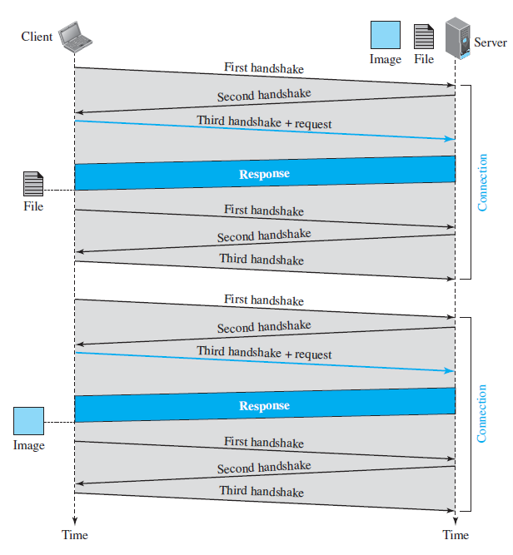
HTTP Request Types: Nonpersistent Connections
Figure shows an example of a nonpersistent connection.
The client needs to access a file that contains one link to an image.
The text file and image are located on the same server.
Here we need two connections.
For each connection, TCP requires at least three handshake messages to establish the connection, but the request can be sent with the third one.

Slide 31
HTTP Request Types: Nonpersistent Connections
After the connection is established, the object can be transferred.
After receiving an object, another three handshake messages are needed to terminate the connection.
This means that the client and server are involved in two connection establishments and two connection terminations.
If the transaction involves retrieving 10 or 20 objects, the round trip times spent for these handshakes add up to a big overhead.

Slide 32
HTTP Request Types: Persistent Connections
In a persistent connection, the server leaves the connection open for more requests after sending a response.
The server can close the connection at the request of a client or if a time-out has been reached.
The sender usually sends the length of the data with each response.
Time and resources are saved using persistent connections.

Slide 33
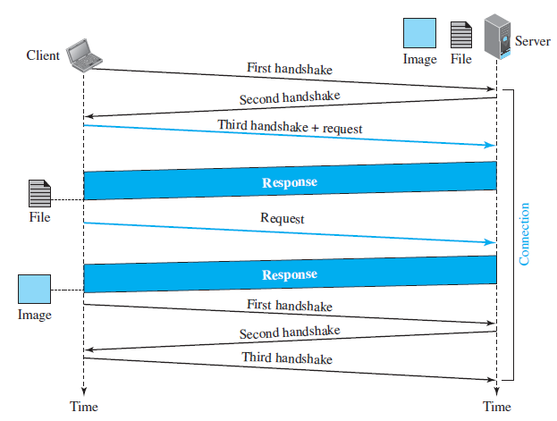
HTTP Request Types: Persistent Connections
Figure shows the same scenario as in previous Example, but using a persistent connection.
Only one connection establishment and connection termination is used, but the request for the image is sent separately.

Slide 34
E- Mail
Electronic mail is one of the most well-known network services.
Electronic mail is a computer-based service that allows users to communicate with one another by exchanging messages.
Email information is transmitted via email servers and uses a variety of TCP/IP protocols.
For example, the simple mail transfer protocol (SMTP) is a protocol that is used to send messages.
Similarly, IMAP or POP receives messages from a mail server.

Slide 35
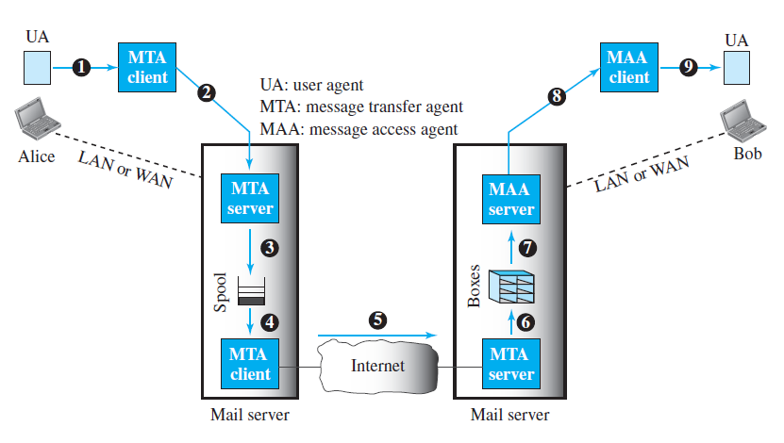
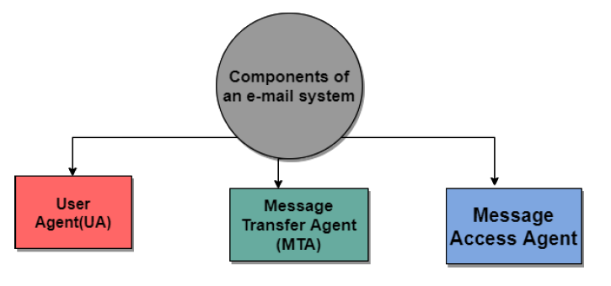
E- Mail: Architecture
Components of Electronic Mail
The following are the essential components of an e-mail system:
1. User Agent (UA)
2. Message Transfer Agent (MTA)
3. Message Access Agent (MAA)

Slide 36
User Agent (UA)
The User Agent (UA) is the component that directly interacts with the email users. It can be thought of as the user interface or email client through which individuals compose, send, receive, and manage their email messages.
User Agents come in various forms, including desktop applications, web-based email services, and mobile apps.
Examples of User Agents include Microsoft Outlook, Gmail, Thunderbird, and Apple Mail.
Key functions of the User Agent include composing new emails, reading incoming emails, organizing messages into folders, and providing a user-friendly interface for email management.
Some of the services supplied by the User-Agent are listed below:
Reading a Message
Sending a reply to a Message
Message Composition
Forwarding a Message
Handling the Message

Slide 37
Message Transfer Agent
The Message Transfer Agent (MTA) is responsible for routing and transporting email messages between mail servers. It acts as an intermediary in the process of sending and receiving emails.
MTAs use the Simple Mail Transfer Protocol (SMTP) for sending and receiving emails. When you send an email, your User Agent communicates with your outgoing mail server (SMTP server), which in turn communicates with the recipient's mail server.
The MTA ensures that emails are delivered to the appropriate destination. If the recipient's server is offline, the MTA will queue the email for later delivery.

Slide 38
Message Access Agent
The Message Access Agent is the component responsible for allowing users to access and manage their email messages stored on a mail server.
There are two common protocols associated with Message Access Agents:
POP3 (Post Office Protocol Version 3): POP3 downloads emails from the server to the user's local device. It is often used when users want to store their emails locally and remove them from the server.
IMAP (Internet Message Access Protocol): IMAP allows users to access their emails on the server itself. This protocol is commonly used when users want to access their emails from multiple devices and have consistent access to their mailbox across all of them.
The Message Access Agent ensures that users can access and manage their emails securely, whether they are stored locally or on the server.

Slide 39
E- Mail
Spontaneity: In a couple of seconds, you may send a message to anybody on the globe.
Asynchronous: You may send the e-mail and let the recipient view it at their leisure.
Attachments of data, pictures, or music, frequently in compressed forms, can be delivered as an e-mail to a person anywhere in the world.
Addresses can be stored in an address book and retrieved instantly.
Through an e-mail, a user can transfer multiple copies of a message to various individuals.

Slide 40
SMTP
SMTP mainly stands for Simple Mail Transfer Protocol.
Basically, the actual transfer of mail is done through the message transfer agents(MTA).
Thus in order to send the mail, the system must have the client MTA and in order to receive the mail, the system must have a server MTA.
In order to define the MTA client and server on the Internet, there is a formal way and it is known as Simple Mail Transfer Protocol(SMTP).
SMTP also makes the use of TCP/IP for sending and receiving e-mail.

Slide 41
SMTP
SMTP is based on the client/server model.
The original standard port for SMTP is Port 25.
Using this protocol, the client who wants to send the e-mail first opens a TCP connection to the SMTP server and then sends the e-mail across the TCP connection.
It is important to note that the SMTP server is always in listening mode.
As soon as it listens for the TCP connection from any client then the connection is Initiated on port 25 and after the successful connection, the client sends the e-mail/message immediately.

Slide 42
SMTP
All the users make use of User Agent (UA).
The Mail Transfer Agent (MTA) mainly helps to exchange all the messages in between both sender and receiver using the TCP/IP.
The system administrator has the authority to configure the set up of local MTA, thus the users who are sending the email do not need to deal with the MTA.

Slide 43
Difference between SMTP and HTTP
SMTP | HTTP
SMTP is used for mail services. | HTTP is mainly used for data and file transfer.
It uses port 25. | It uses port 80.
It is primarily a push protocol. | It is primarily a pull protocol.
It imposes a 7-bit ASCII restriction on the content to be transferred. | It does not impose a 7-bit ASCII restriction. Can transfer multimedia, hyperlinks, etc.
SMTP transfers emails via Mail Servers. | HTTP transfers files between the Web server and the Web client.
SMTP is a persistent type of TCP connection. | It can use both Persistent and Non-persistent.
Uses base64 encoding for authentication. | Uses different methods of authentication such as basic, digest, and OAuth.
Does not support session management or cookies. | Supports session management and cookies to maintain state.
Has a smaller message size limit compared to HTTP. | Has a larger message size limit compared to SMTP.
Requires authentication for sending emails. | Does not require authentication for browsing web pages.
Supports both plain text and encrypted communication (SMTPS or STARTTLS). | Supports both plain text and encrypted communication (HTTPS).

Slide 46
DNS (Domain Name Space)
Domain name space refers to the global system of unique addresses on the internet, while domain name system (DNS) is the system that translates hierarchical domain names into IP addresses.
The DNS namespace is organized hierarchically, with the root of the hierarchy at the top. At the root of the DNS namespace, there are a number of top-level domains (TLDs), such as .com, .net, and .org.
These TLDs are further divided into second-level domains, and so on.

Slide 47
DNS (Domain Name Space)
For example, consider the domain name "example.com". "com" is the top-level domain, and "example" is the second-level domain.
"Example.com" can have subdomains beneath it, "mail.example.com".
Each subdomain can also have further subdomains beneath it, forming a tree-like structure.

Slide 48
Domain Name System (DNS)
The Domain Name System (DNS) is the phonebook of the Internet. Humans access information online through domain names, like nytimes.com or espn.com.
Web browsers interact through Internet Protocol (IP) addresses. DNS translates domain names to IP addresses so browsers can load Internet resources.

Slide 49
Purpose of Domain Name System (DNS)
The DNS is a fundamental component of the internet's infrastructure. Its primary purpose is to translate human-readable domain names (like www.example.com) into numeric IP addresses (e.g., 203.0.113.7). The DNS system is used to:
Simplify Internet Navigation: DNS abstracts the complexity of IP addresses, making it easier for users to access websites and services by typing domain names.

Slide 50
Uses of DNS
DNS serves several essential functions in the world of computer networks and the internet:
Web Browsing: DNS is crucial for web browsing. When you type a URL into your browser, DNS resolution is initiated to find the IP address of the web server hosting that site.
Email Communication: DNS is used to route emails. When you send an email, DNS helps identify the recipient's email server by resolving the domain name in their email address.
Network Services: DNS plays a key role in various networked services, including file sharing, online gaming, and remote access. It enables devices to locate each other on the internet.

Slide 51
Working of DNS
Example:
Let's use an example to illustrate how DNS works. Suppose you want to visit "www.example.com":
You type "www.example.com" into your web browser.
Your computer's DNS resolver sends a request to a root server to find out which TLD (Top-Level Domains) server handles ".com."
The root server directs the resolver to the TLD server responsible for ".com."
The TLD server then points the resolver to the authoritative name server for "example.com."
The authoritative name server for "example.com" provides the IP address (e.g., 203.0.113.7) associated with "www.example.com."
Your browser uses this IP address to connect to the web server hosting www.example.com, and the website is displayed.

Slide 53
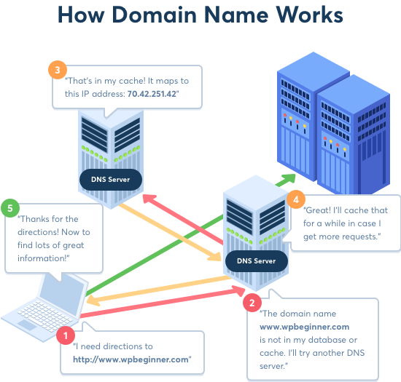

Slide 54
What are the steps in a DNS lookup?
For most situations, DNS is concerned with a domain name being translated into the appropriate IP address.
To learn how this process works, it helps to follow the path of a DNS lookup as it travels from a web browser, through the DNS lookup process, and back again.
Let's take a look at the steps.

Slide 56
What are the steps in a DNS lookup?
The 8 steps in a DNS lookup:
A user types ‘example.com’ into a web browser and the query travels into the Internet and is received by a DNS recursive resolver.
The resolver then queries a DNS root nameserver (.).
The root server then responds to the resolver with the address of a Top Level Domain (TLD) DNS server (such as .com or .net), which stores the information for its domains. When searching for example.com, our request is pointed toward the .com TLD.
The resolver then makes a request to the .com TLD.
The TLD server then responds with the IP address of the domain’s nameserver, example.com.

Slide 58
What are the steps in a DNS lookup?
6. Lastly, the recursive resolver sends a query to the domain’s nameserver.
7. The IP address for example.com is then returned to the resolver from the nameserver.
8. The DNS resolver then responds to the web browser with the IP address of the domain requested initially.
Once the 8 steps of the DNS lookup have returned the IP address for example.com, the browser is able to make the request for the web page:
9. The browser makes a HTTP request to the IP address.
10. The server at that IP returns the webpage to be rendered in the browser (step 10).

Slide 59
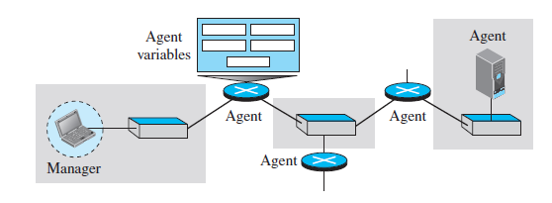
SNMP
Simple Network Management Protocol (SNMP) is an application-layer protocol for monitoring and managing network devices on a local area network (LAN) or wide area network (WAN).
The purpose of SNMP is to provide network devices, such as routers, servers and printers, with a common language for sharing information with a network management system.

Slide 60
SNMP components
There are 3 components of SNMP:
1) SNMP Manager – It is a centralized system used to monitor network. It is also known as Network Management Station (NMS)
2) SNMP agent –It is a software management software module installed on a managed device. Managed devices can be network devices like PC, routers, switches, servers, etc.
3) Management Information Base – MIB consists of information on resources that are to be managed. This information is organized hierarchically. It consists of objects instances which are essentially variables.

Slide 61
SNMP messages
Different variables are:
GetRequest – SNMP manager sends this message to request data from the SNMP agent. It is simply used to retrieve data from SNMP agents. In response to this, the SNMP agent responds with the requested value through a response message.
2. GetNextRequest – This message can be sent to discover what data is available on an SNMP agent. The SNMP manager can request data continuously until no more data is left. In this way, the SNMP manager can take knowledge of all the available data on SNMP agents.

Slide 62
SNMP messages
3. GetBulkRequest – This message is used to retrieve large data at once by the SNMP manager from the SNMP agent. It is introduced in SNMPv2c.
4. SetRequest – It is used by the SNMP manager to set the value of an object instance on the SNMP agent.
5. Response – It is a message sent from the agent upon a request from the manager. When sent in response to Get messages, it will contain the data requested. When sent in response to the Set message, it will contain the newly set value as confirmation that the value has been set.

Slide 63
SNMP messages
6. Trap – These are the message sent by the agent without being requested by the manager. It is sent when a fault has occurred.
7. InformRequest – It was introduced in SNMPv2c, used to identify if the trap message has been received by the manager or not. The agents can be configured to send trap message continuously until it receives an Inform message. It is the same as a trap but adds an acknowledgement that the trap doesn’t provide.

Slide 64
Strength of SNMP
1. It is simple to implement.
2. Agents are widely implemented.
3. Agent level overhead is minimal.
4. It is robust and extensible.
5. Polling approach is good for LAN based managed object.
6. It offers the best direct manager agent interface.
7. SNMP meet a critical need.

Slide 65
Limitation of SNMP
1. It is too simple and does not scale well.
2. There is no object oriented data view.
3. It has no standard control definition.
4. It has many implementation specific (private MIB) extensions.
5. It has high communication overhead due to polling

Slide 66
Streaming Stored Audio/Video
Streaming stored audio/video, the files are compressed and stored on a server.
A client downloads the files through the Internet.
This is sometimes referred to as on-demand audio/video.
Examples of stored audio files are songs, symphonies, books on tape, and famous lectures.
Examples of stored video files are movies, TV shows, and music video clips.

Slide 67
Streaming Stored Audio/Video
Downloading these types of files from a Web server can be different from downloading other types of files.
There four approaches, each with a different complexity.
First Approach: Using a Web Server
Second Approach: Using a Web Server with a Metafile
Third Approach: Using a Media Server
Fourth Approach: Using a Media Server and RTSP

Slide 68
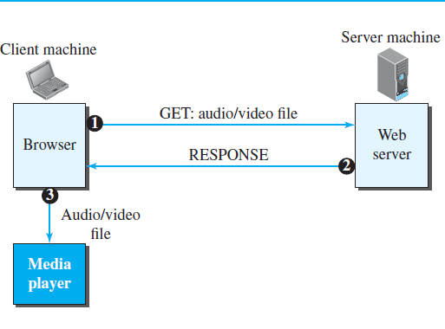
First Approach: Using a Web Server
A compressed audio/video file can be downloaded as a text file.
The client (browser) can use the services of HTTP and send a GET message to download the file.
The Web server can send the compressed file to the browser.
The browser can then use a help application, normally called a media player.
This approach is very simple and does not involve streaming.
However, it has a drawback. An audio/video file is usually large even after compression. An audio file may contain tens of megabits, and a video file may contain hundreds of megabits.
In this approach, the file needs to download completely before it can be played.

Slide 69
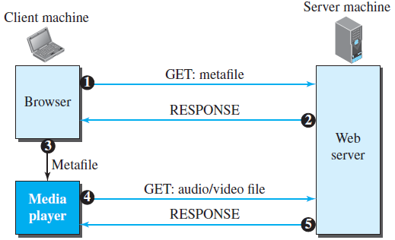
Second Approach: Using a Web Server with a Metafile
In another approach, the media player is directly connected to the Web server for downloading the audio/video file.
The Web server stores two files: the actual audio/video file and a metafile that holds information about the audio/video file.
Figure shows the steps in this approach as follows
The HTTP client accesses the Web server using the GET message.
The information about the metafile comes in the response.
The metafile is passed to the media player.
The media player uses the URL in the metafile to access the audio/video file.
The Web server responds.

Slide 70
Third Approach: Using a Media Server
The problem with the second approach is that the browser and the media player both use the services of HTTP.
HTTP is designed to run over TCP.
This is appropriate for retrieving the metafile, but not for retrieving the audio/video file.
The reason is that TCP retransmits a lost or damaged segment, which is counter to the philosophy of streaming.
So there is a need to dismiss TCP and its error control; we need to use UDP.
However, HTTP, which accesses the Web server, and the Web server itself are designed for TCP; we need another server, a media server.

Slide 71
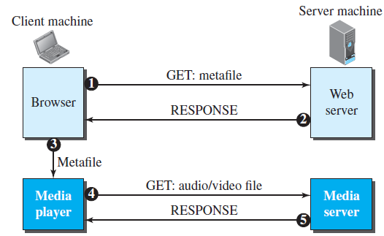
Third Approach: Using a Media Server
Figure shows the concept.
The HTTP client accesses the Web server using a GET message.
The information about the metafile comes in the response.
The metafile is passed to the media player.
The media player uses the URL in the metafile to access the media server to download the file. Downloading can take place by any protocol that uses UDP.
The media server responds.

Slide 72
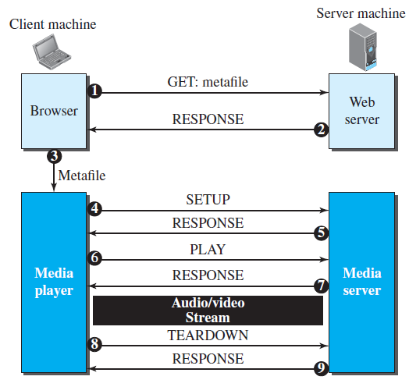
Fourth Approach: Using a Media Server and RTSP
The Real-Time Streaming Protocol (RTSP) is a control protocol designed to add more functionalities to the streaming process. Using RTSP, we can control the playing of audio/video.
RTSP is an out-of-band control protocol.
Figure shows a media server and RTSP

Slide 73
Fourth Approach: Using a Media Server and RTSP
1. The HTTP client accesses the Web server using a GET message.
2. The information about the metafile comes in the response.
3. The metafile is passed to the media player.
4. The media player sends a SETUP message to create a connection with the media server.
5. The media server responds.
6. The media player sends a PLAY message to start playing (downloading).
7. The audio/video file is downloaded using another protocol that runs over UDP.
8. The connection is broken using the TEARDOWN message.
9. The media server responds.
The media player can send other types of messages. For example, a PAUSE message temporarily stops the downloading; downloading can be resumed with a PLAY message.

Slide 74
Fourth Approach: Using a Media Server and RTSP
Example: Video on Demand (VOD)
Video On Demand (VOD) allows viewers to select a video from a large number of available videos and watch it interactively: pause, rewind, fast forward, etc.
A viewer may watch the video in real time or may download the video into her computer, portable media player, or to a device such as a digital video recorder (DVR) and watch it later.
Cable TV, satellite TV, and IPTV providers offer both pay-per-view and free content VOD streaming.
Many other companies, such as Amazon Prime video, Netflix and video rental companies such as Blockbuster video, also provide VOD.
Internet television is an increasingly popular form of video on demand.

